Slide 1

SeeTest Mobile Automation

Slide 2
Agenda
Mobile Application Testing
Challenges of testing mobile application
Mobile Automation - What is it?
Tools available in the market
Why SeeTest ?
Seetest key Capabilities
Demo
Questions

Slide 3
Mobile Application Testing
Mobile devices have seen tremendous growth over the past decade. With lots of mobile applications being developed these days, confirming quality has become so key to prevent revenue loss, lost productivity and damage to brand reputation. A thorough test strategy needs to follow in order to get apps in good shape, reach market on time, within budget and to work well across devices.
Target Device Selection (Test environment should have a mix of Simulators and Real devices)
Internet Connectivity (Wi-Fi, Cellular)
Test Automation (Reduce effort of Regression by selecting an effective automation tool)
Different testing aspects (Usability, Performance, Security, Reliability etc.)

Slide 4
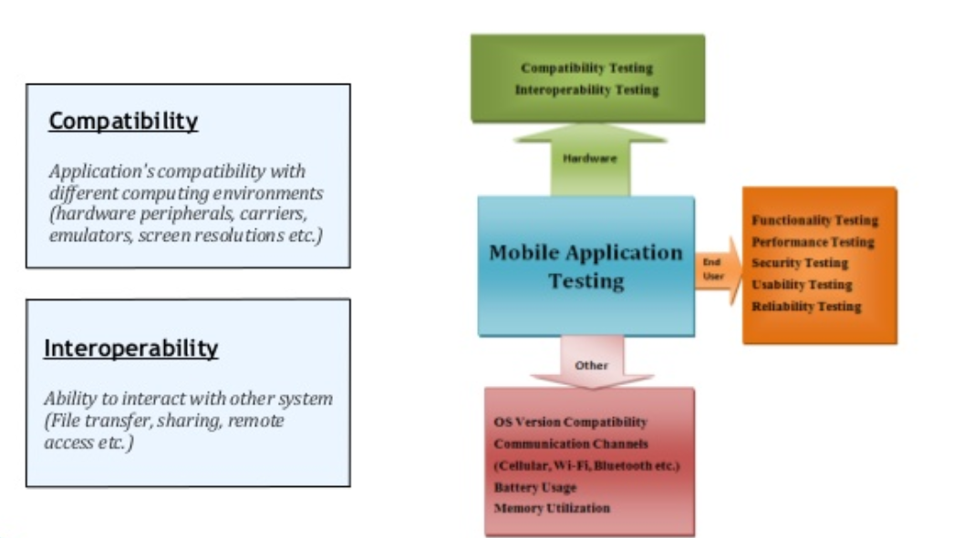
Mobile Application Testing

Slide 5
Challenges
Compatibility Testing
Testing across Mobile devices (Emulators, Real devices etc.)
Testing across OS flavors (Android, iOS, Windows etc.)
Testing across networks (Wi-Fi, Cellular etc.)
Testing across different Resolutions, Screen sizes
Regression Testing
Before moving updates to Production, doing thorough Regression testing is very crucial. Automation is MUST here to reduce efforts, time to market and enhance productivity

Slide 6
Mobile Automation
Automation of mobile applications is one of MOST emerging prospect in today's Agile world and can provide many advantages:
Efficiency of testing process improve as Automation is accurate and work as designed
Automation tests can be run repeatedly and consistently
Remove headache of Regression tests with every release
Improved test coverage in shorter time span

Slide 7
Mobile Automation Tools
Key factors in selecting right Mobile automation tools
Support for multiple platforms
List current and future target platforms and ensure tool supports them.
Support for blackbox testing
Ensure tool functions well without having access to application source code
Root or Jailbreak requirement
Tool should work well across device which has not been rooted or jail broken
Support for Integration into CI Servers
Automation Scripts should be able to run from CI servers

Slide 8
Mobile Automation Tools
Platform Specific Tools
iOS Instrumentation, MonkeyRunner, UIAutomator
Functional Testing Tools
Robotium, Appium, MonkeyTalk, Selendroid, ios-driver ,Seetest
Unit Testing Tools
Android JUnit, Roboelectric, OCUnit ,Seetest
Performance Testing Tool
NeoLoad, Seetest

Slide 9
Why Seetest ? Why Not Appium?
If you encounter any difficulty in using Seetest, there's a whole support team out there which is ready to help you anytime. While Appium is a tool which is still undergoing changes/upgrades, so you have to rely on online communities for support.
Seetest gives you 100% results in terms of performance, while Appium may sometimes fail, and not perform the required actions.
It took us quite a lot of time to get going with Appium and even now, we keep getting new errors which we had never encountered until now.
Seetest provides a vast range of methods to use, while Appium is limited in number of methods.

Slide 10
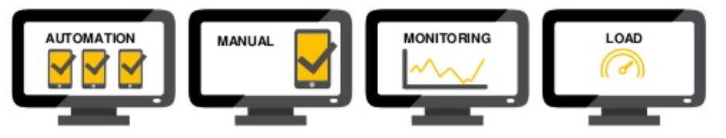
Seetest
SeeTest testing tools are manufactured by Experitest
Provides Quality Assurance Tools for Mobile Testing
End-to-End Product Suite - Manual, Automation, Monitoring, Load, Network Virtualization, Application Manager AUTOMATION MANUAL MONITORING LOAD

Slide 11
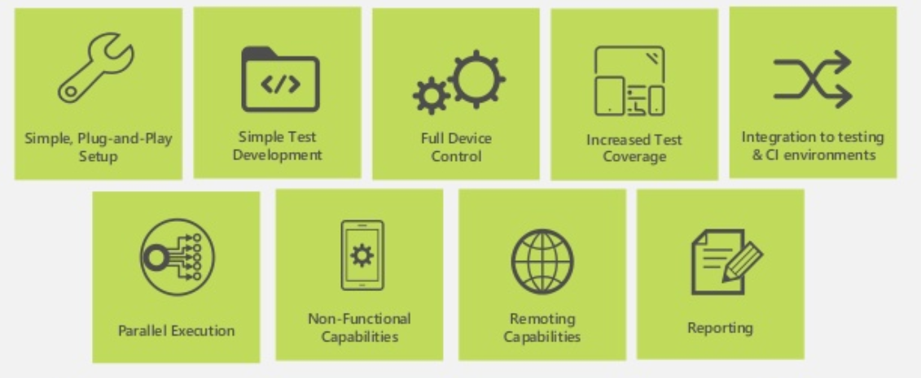
Seetest Key Capabilities
Key Capabilities
Simple, Plug and Play Set up
Simple Test Development
Full Device Control
Increase Test Coverage
Integration With CI
Parallel Execution
Remoting Capabilities
Reporting

Slide 12
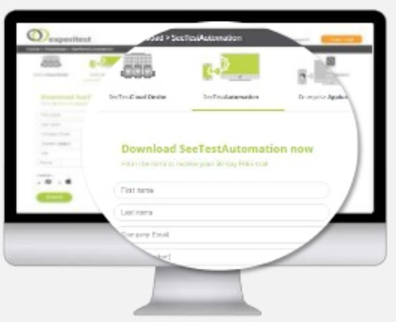
Simple Plug-and-Play Setup
Set up your mobile test automation environment in minutes. No Installation necessary, use the web based interface to develop and execute automated tests on remote mobile devices, simulators or emulators
Installed version is available with one-click executable file and no additional environment dependencies
Automated registration of Apple devices to Apple developer accounts that eliminates the provisioning process
iOS and Android devices can be tested on either Windows or MAC machines
Out of the box management and customizable reporting systems included
Grid tool for mass parallel test execution

Slide 13
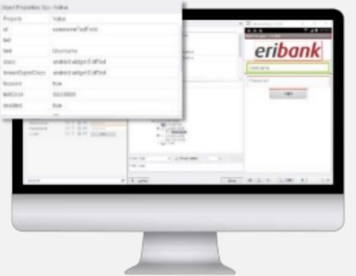
Simple Test Development Easily develop test scripts for all mobile operating systems using unique test development tools
Test recorder, to develop and run automated tests
Object spy
XPath query
Step by step reporting
Execution commands and element highlighting
Object repository and dynamic identification
Offline analysis for element identification failure
Test code generation
Simulators and Emulators are fully supported
Advanced object Identification:
• Identify objects by their properties
• Identify customized UI elements
• Also support identification by image or text recognition

Slide 14
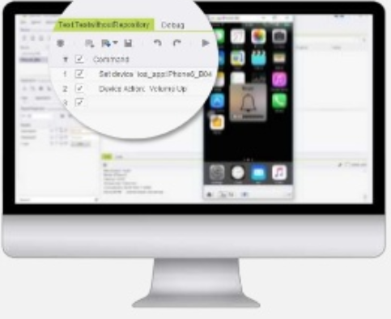
Full Device Control Automate any mobile application scenario by fully controlling remote mobile devices
Gestures Multi touch
Swipe
Flick
Drag & Drop
Zoom in and out
Scroll including conditional scrolling
Shake
Pinch
Force touch (iOS)
Full power cycle - Reboot your device, reset or disconnect USB connection
All device virtual and physical buttons supported (home, volume, power, recent apps)
Display mode (portrait / landscape)
Trigger incoming SMS/Calls

Slide 15

Increase Test Coverage Test all types of mobile applications, and automate advanced mobile application scenarios
All apps types:
Native, Web and Hybrid Applications
System & MDM apps (Device settings, SMS verification)
Non-packaged apps (Facebook, LinkedIn etc.)
All functionality:
Scanned-image testing (e.g. barcode, check scanning)
Voice testing (e.g. Audio injection, Siri integration, Ok Google integration)
Location-based testing (GPS simulation)
Authentication simulation (e.g. TouchID, Password, Pin, Pattern
Support for all beta versions of mobile OS within 2 weeks from release to the market

Slide 16
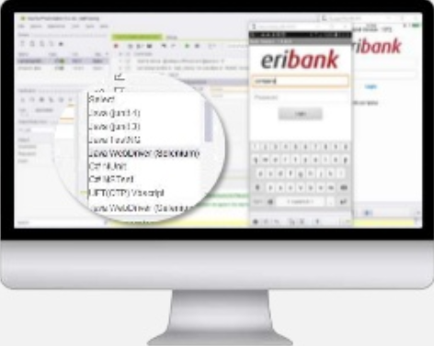
Integration with test frameworks/IDEs & CI environments Integrate seamlessly into existing testing and continuous integration environments
Full integration with testing environment
Run or develop WebDriver (Selenium, Appium) tests
Program in Java along JUnit3, JUnit4, TestNG frameworks
Plug-in to Microsoft Visual Studio Testing & Monitoring tools with C# MSTest, C# NUnit test frameworks
Script on Python 2.7 and 3.0
Integrate with IBM Rational
Plug-in to TestComplete
Work with any HP version inc. UFT V 12 (and all older QTP versions starting from QTP v 9.X)
Full and seamless integration with Continuous Integration (CI) environments
Work with Hudson, Jenkins, TeamCity, as well as Quality Center, TFS, JUnit, NUnit, PyUnit, TestNG, Ant
Create and edit Jira issues
Submit your automated run results to QC
Plug-in to HP QC, LoadRunner

Slide 17
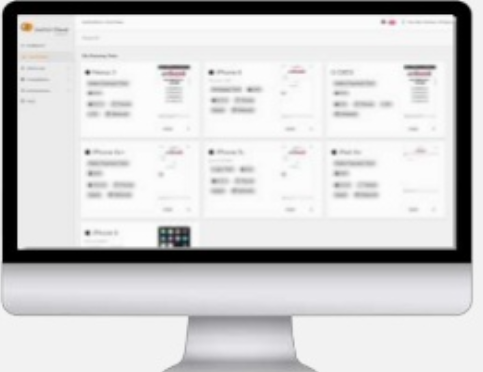
Parallel Execution Achieve continuous testing with large-scale parallel execution of mobile tests on local or remote devices
Out-of-the-box parallel execution of tests on locally connected physical devices
Large scale parallel execution of tests on remotely located mobile devices using SeeTest Grid Execution enabling:
Dynamic test scheduling, execution, and distribution according to specific attributes such as device manufacture, model, OS version
Mass deployment of apps on target devices (RESTful API)
Triggering tests directly from the CI station

Slide 18
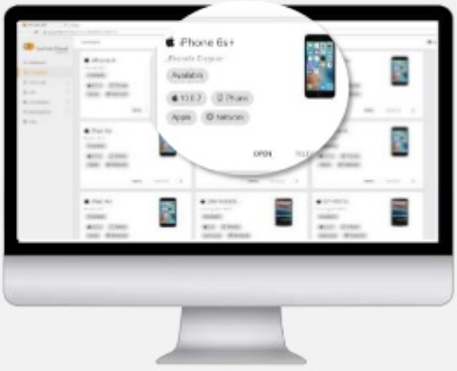
Remoting Capabilities Test automation with remote access to physical mobile devices
Gain secure access to one, or many Experitest managed devices located in Experitest’s data centers around the globe (SaaS Digital Assurance lab)
Create an on premise mobile device lab of physical or emulated mobile devices that reside securely within your company’s VPN (On-premise Digital Assurance Lab)

Slide 19
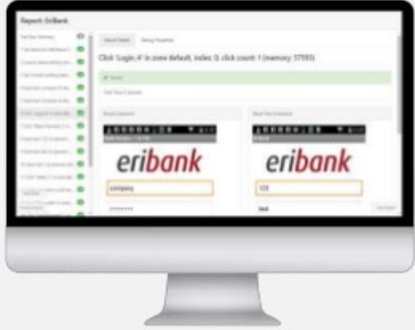
Reporting Effectively manage large scale mobile automation with advanced reporting, parallel execution, and management systems
Generate a single test execution report
Automatically generates a detailed test reports
Reports include screenshots and videos of every step of the test
Reports indicate if the specific test passed or failed and show the exact step where it failed
Pull device logs View the device's log files during test runs and save them for fault investigation

Slide 20
Any Questions?

Slide 21
Thank You

